Slide 1
🏦 Banking Customer Analytics
SQL & Power BI: End-to-End Project

Slide 2
Introduction:
The Banking Customer Analytics Project helps banks understand their customers and daily operations better by studying their data.
It uses information from five main tables — Customers, Accounts, Transactions, Branches, and Employees — to explore how customers use their accounts, how often they make deposits or withdrawals, and how different branches and employees perform.
This analysis helps the bank make smarter decisions and improve overall customer satisfaction.

Slide 3
Objective :
The main objective of this project is to analyze customer and banking data to find useful patterns and insights.
It aims to:
Understand customer transaction behavior and account usage.
Identify the most active branches and employees.
Detect trends in deposits and withdrawals.
Find customers likely to become inactive.
Support better decision-making for marketing and service improvement.

Slide 4
Dataset Overview:
Table:
1 . branch1
Table:
1 . accounts1
Column Name | Description
account_number | Unique ID for each account
customer_id | ID of the customer who owns the account
account_type | Type of account (e.g., Savings, Current)
balance | Current balance of the account
branch_id | ID of the branch where the account is held
created_at | Date the account was created
Column Name | Description
branch_id | Unique ID for each branch
branch_name | Name of the branch
branch_address | Street address of the branch
branch_location | Specific location or area of the branch
city | City where the branch is located
state | State where the branch is located
zip_code | Postal code of the branch
phone | Contact number of the branch

Slide 5
Dataset Overview:
Table:
3 . customers1
Table:
4 . employees1:
Column Name | Description
customer_id | Unique ID for each customer
first_name | Customer’s first name
last_name | Customer’s last name
date_of_birth | Customer’s birth date
email | Customer’s email address
phone | Customer’s contact number
address | Customer’s street address
city | City where the customer lives
state | State where the customer lives
zip_code | Postal code of the customer
created_at | Date the customer record was created
Column Name | Description
employee_id | Unique ID for each employee
first_name | Employee’s first name
last_name | Employee’s last name
email | Employee’s email address
phone | Employee’s contact number
hire_date | Date the employee was hired
position | Employee’s job title or role
branch_id | ID of the branch where the employee works

Slide 6
DATASET OVERVIEW: Table: 5 . transactions1
Column Name | Description
transaction_id | Unique ID for each transaction
account_number | ID of the account associated with the transaction
transaction_type | Type of transaction (e.g., Deposit, Withdrawal, Transfer)
amount | Amount of money involved in the transaction
transaction_date | Date when the transaction occurred

Slide 7
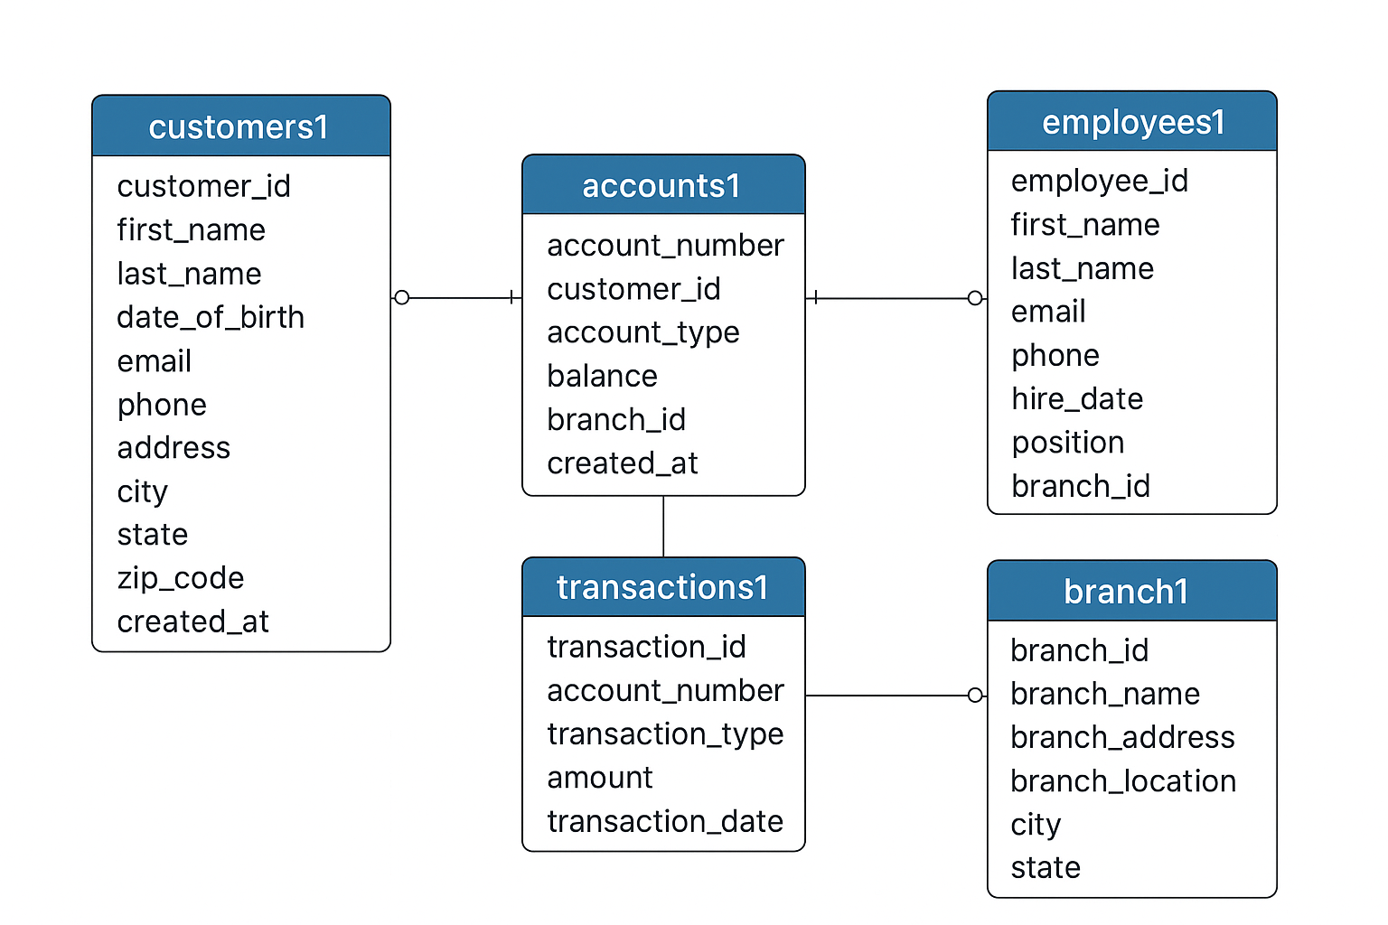
Data Modelling:

Slide 8
🧠 Customer Insight:
How many customers are there in each city?
Which account type has the highest average balance?
Who are the top 5 customers with the highest account balances?
Which customer holds the highest balance in each branch?
Which customers have high account balances but low transaction activity?
Which customers frequently make small withdrawals?
Which customers have deposited the highest total amount of money?

Slide 9
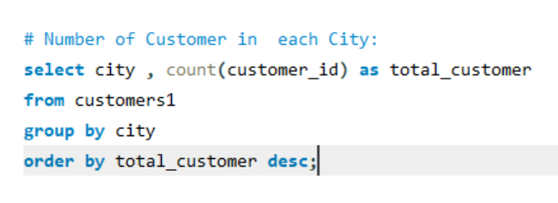
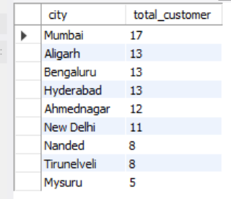
1.1 Customer Insight:
Insight:
This Query identifies the strong customer base.
Mumbai has the highest number of customers while Mysuru has least number of customers .
Cities with more customers indicate strong market presence, while fewer customers cities highlight growth opportunities.
Objective : To Analyze Customers Distribution

Slide 10
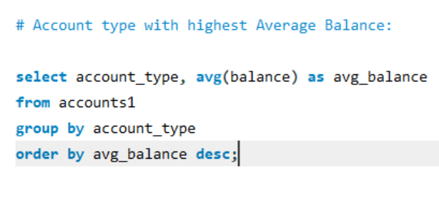
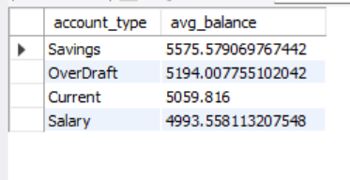
1.2 Customer Insight:
Insight: This query Identifies which account types contribute most to the bank’s deposits.
Savings has the highest average balance.
How to use this information to improve marketing and promote deposits.
1.Buildings better marketing strategies for high-balance account types.
2Identify opportunities to promote certain accounts to increase overall deposits.
3. Evaluate customer preferences and financial behavior across account types.
Objective : To find accounts with highest Average balances

Slide 11
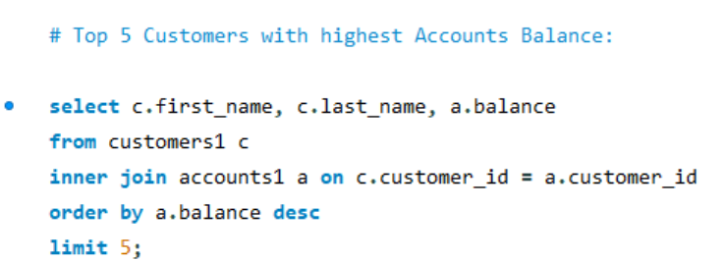
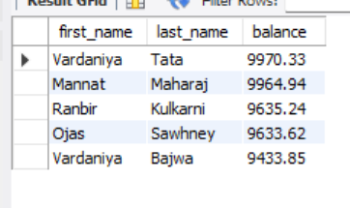
1.3 Customer Insight:
Insight :
This query helps to identifies the bank’s most valuable customers who hold the largest funds.
Vardaniya Tata has the highest account balance.
Shows how deposits are concentrated among top clients. Helps the bank to offer personalized services and retain these high-value customers.
Objective : To find out the most valuable customers

Slide 12
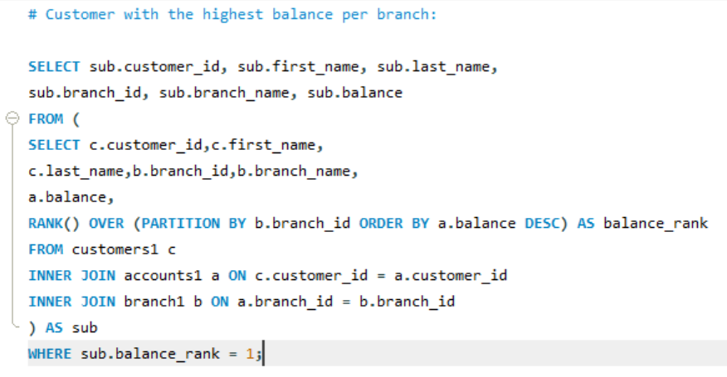
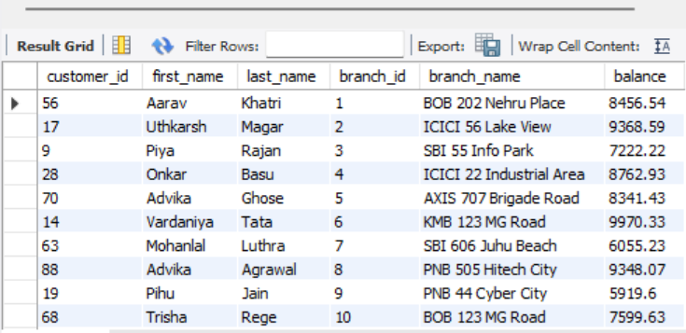
1.4 Customer Insight:
Insight : It finds the top depositors in each branch to see which branches have more money and rely on big clients.
Help branch managers focus on important customers and understand which branches attract wealthier clients.
Objective : To identify the high value customer per branch.

Slide 13
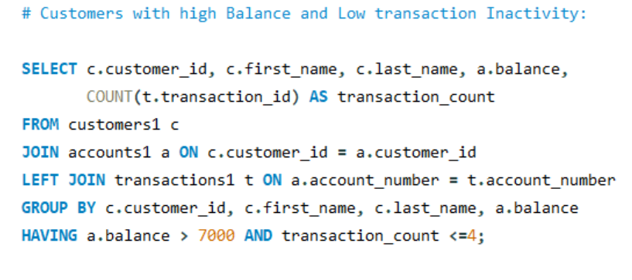
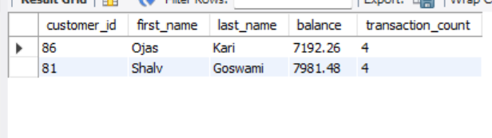
1.5 Customer Insight:
Insight: Ojas Kari and Shalv Goswami has the high balance but low transaction count.
These customers are very important for bank because they hold the large amount of money representing potential revenue and stability.
How to make them active ?
1.Bank can make them active by giving higher interest rates, cashback or rewards for transactions.
2.Offering premium services, advisory, or priority support to engage them.
3.Send alerts, tips, or product suggestions to encourage account activity
Objective : To find wealthy but inactive customers.

Slide 14
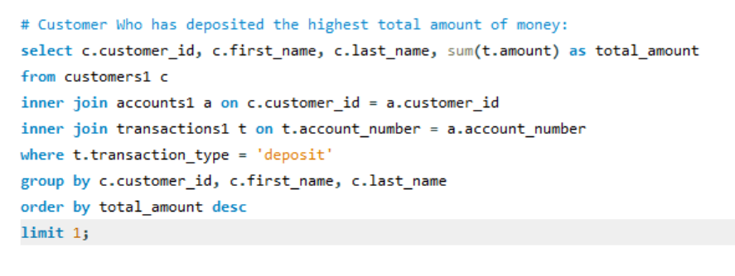
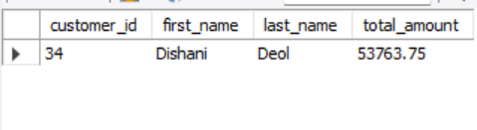
1.6 Customer Insight
Insight :
The query identify the most valuable depositor, providing insights on customer worth and behavior.
Dishani Deol is the most valuable depositor
How to retain the high value depositor:
Retain high-value customers by offering personalized engagement, premium services, proactive support, loyalty programs, and relevant cross-selling opportunities.
Objective : To find out the most valuable depositor

Slide 15
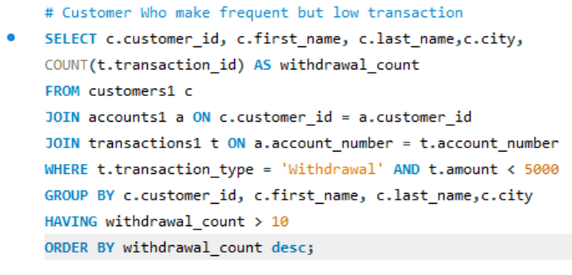
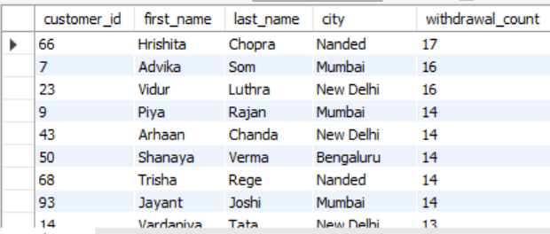
1.7 Customer Insight
Insight:
Hrishita Chopra from Nanded City has the highest Withdrawal Count
How can bank reduce the Operational Cost ?
1.Spot opportunities to promote digital payments, savings plans, or microservices.
2.Help ATM cash planning for branches if many customers are making small withdrawals frequently.
Conclusion: These are likely active, low-value transaction customers. Banks can tailor services for convenience or digital engagement to reduce operational costs.
Objective : To find out the most active customer in terms of Withdrawal.

Slide 16
💳 2. Transactions Insight:
What is the total transaction count and total transaction amount by transaction type?
Which customers have the highest transaction volumes?
What is the monthly trend of total transactions?
Which are the top three months with the highest transaction amounts?
What are the top three highest transactions per branch?
What is the monthly growth rate of transactions?
What is the total transaction count and amount per account per month?
What is the total transaction amount performed by each customer group?

Slide 17
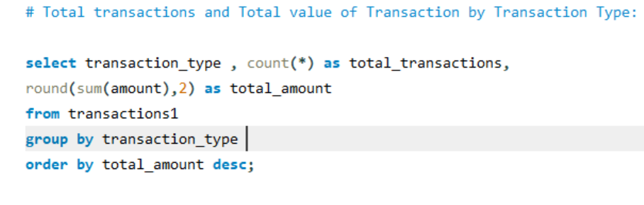
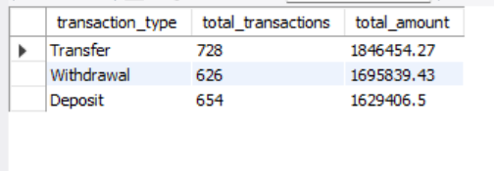
2.1Transactions Insight:
Insight:
Transfers are higher than withdrawals and deposits, showing customers frequently move money between accounts.
This indicates heavy use of transfer services and digital banking. The bank can focus on improving transfer features and monitoring high-volume transactions.
Objective : To understand customer transaction behavior.

Slide 18
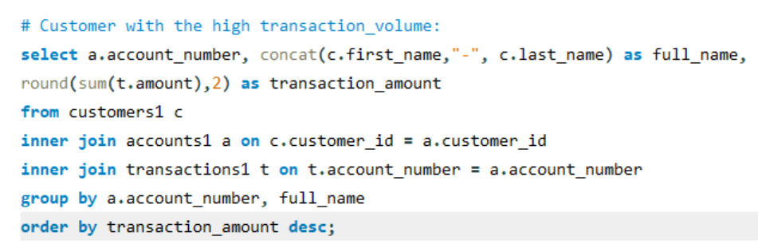
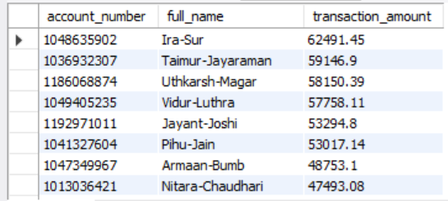
2.2Transactions Insight:
Insight: Ira sur is associated with the highest transaction amount
Customers with the highest transaction volume are the most active users of the bank.
They make frequent deposits, withdrawals, and transfers, showing clear engagement patterns.
The bank can use this information to provide personalized services and tailored offers to these active clients.
Objective : To Find out Highly Active Accounts

Slide 19
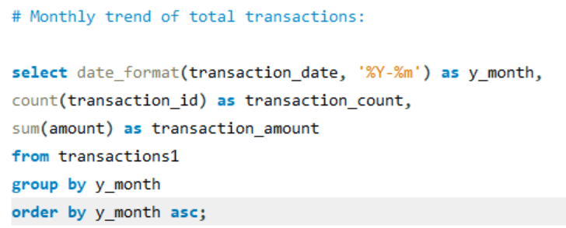
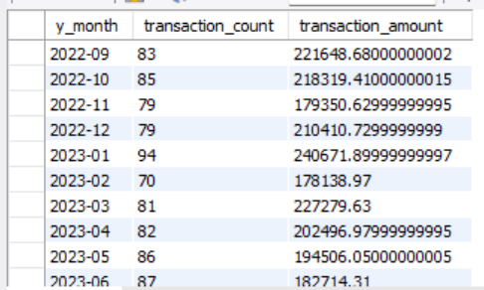
2.3 Transaction insight
Insight :
Shows which months have more or fewer transactions.
Helps to track if transactions are increasing or decreasing over time.
Helps to predict future trends and plan business activities.
Aids in managing staff and resources during busy or slow months.
Objective : To track seasonal transactions trends

Slide 20
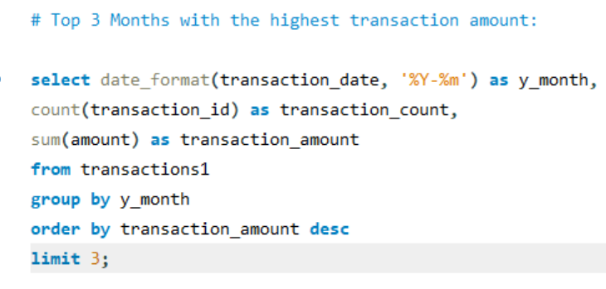
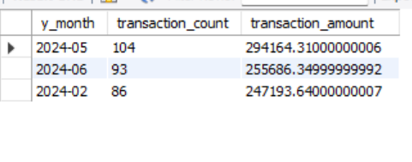
2.4 Transactions Insight:
Insight : May 2024 is the month with highest transaction count and transaction amount
Possible Reasons:
1.Higher spending due to summer sales, travel or festive shopping.
2.Bonuses and incentives in May month increased customer spending.
3.Heavy promotions and cashback offers encouraged more transactions.
Conclusion:
It helps businesses or banks recognize high-performing months, analyze the reasons behind increased activity, and use that insight for strategic planning, marketing, or resource allocation.
Objective : To identify when customer spending or transactions activity peaks

Slide 21
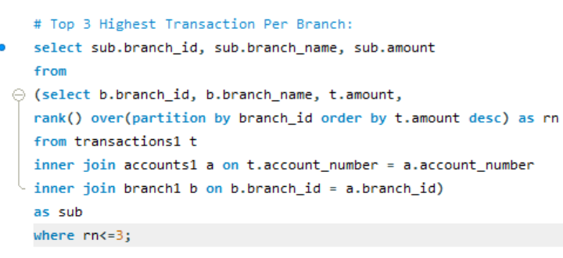
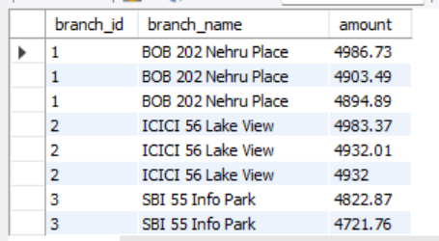
2.5 Transaction Insight
Insight :
1. It identifies the branches handling the largest transactions.
2. Highlighting high value customers.
3. Shows which branch contribute most to revenue
4. Helps in monitoring large or risky transactions
Objective : To analyze branch handling large or high-value transactions, indicating key customers or business activity concentration.

Slide 22
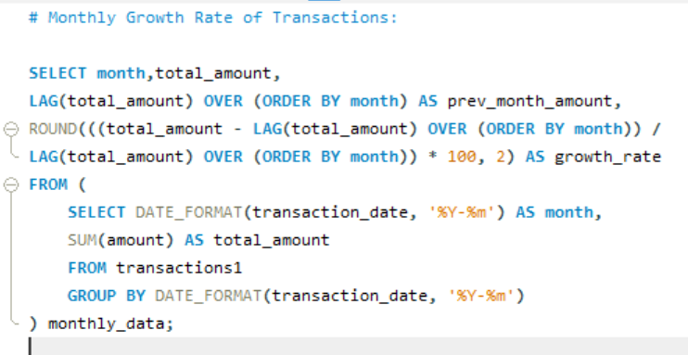
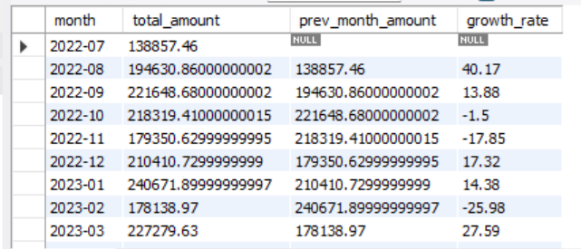
2.6 Transaction Insight:
Insight:
Tracks monthly transaction trends to identify growth or decline in activity.
Highlights months with significant spikes or drops, signaling unusual patterns.
Identifies seasonal or recurring trends in customer transaction behavior.
Evaluates the impact of promotions or campaigns on transaction volume.
Objective : To track whether transaction activity is increasing, decreasing or stable over time

Slide 23
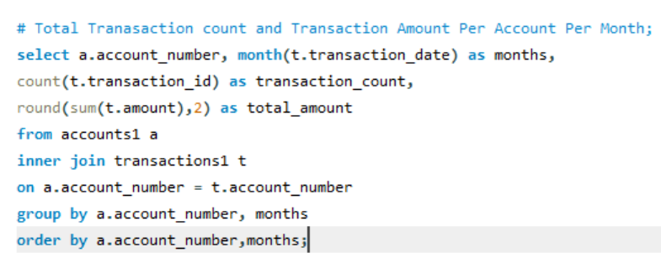
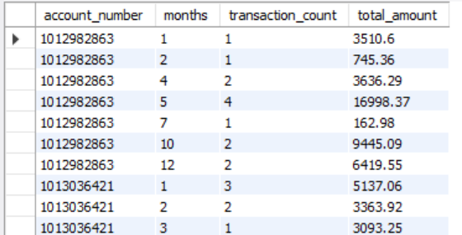
2.7 Transaction Insight:
Conclusion:
1. Target high-value/high-activity accounts for premium services, loyalty rewards, or upselling opportunities.
2. Re-engage low-activity accounts with promotions or personalized communication.
3. Plan campaigns around trends – use months with historically high transactions to maximize offers or marketing impact.
4.Monitor for anomalies – sudden large transaction amounts or counts may indicate errors or potential fraud.
Objective : To monitor account activity over time

Slide 24
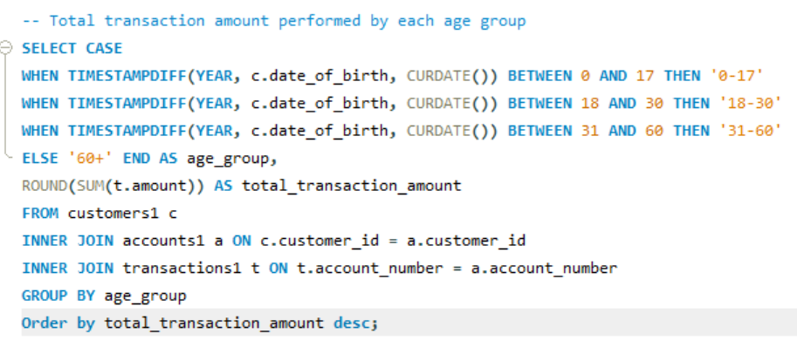
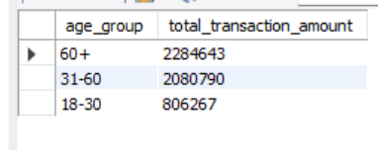
2.8 Transactions Insight
Objective : To analyze transaction behavior across different age group.
Insight:
1.Older customers are more valuable in terms of transaction amounts:
Focused marketing, loyalty programs, or premium services can be targeted to the 60+ age group for higher revenue impact.
2.Middle-aged customers are a steady segment:
They are active, so retention strategies and mid-tier offers can maintain or grow their spending.
3.Young adults have potential for growth:
Their lower transaction amounts may indicate untapped potential. Promotions, digital-first campaigns, or starter offers could increase engagement in this age group.

Slide 25
🏦 3.Branch Insights:
Find out the branches with total balance across all accounts and total number of customers associated with it.
How many employees work in each branch?
Which branches have the highest transaction volume?
Which branch has the highest average account balance?

Slide 26
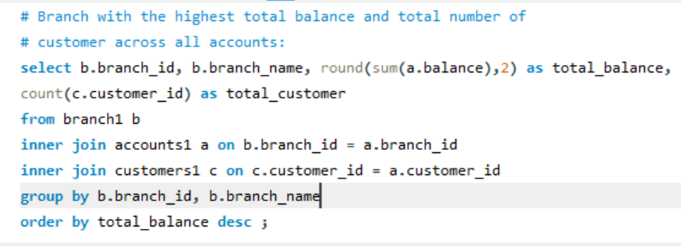
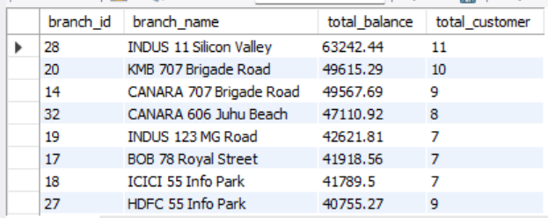
3.1 Branch Insight
Insight : Branch Indus Silicon Valley has the highest total balance and highest number of customers across all branches.
1.High total balance + high customer count = Branch is performing strongly, both in volume and customer reach.
2.High total balance + low customer count = Branch serves a few high-value customers (possible VIP or corporate accounts).
3.Low total balance + high customer count = Many low-value or inactive accounts; potential to increase engagement or cross-sell.
4.Low total balance + low customer count = Branch may be underperforming or located in a less active region.
Objective : To Measure branch Performance by deposit

Slide 27
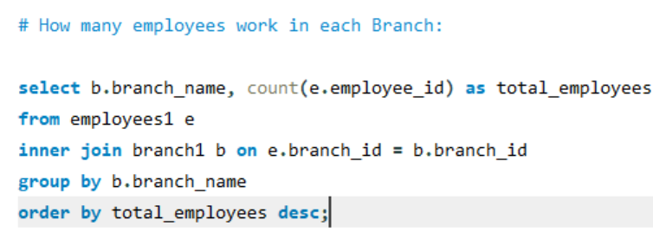
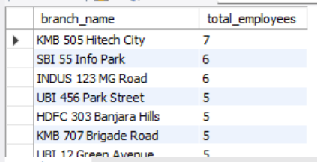
3.2 Branch Insight
Insight :
KMB 505 Hitech City has the highest number of employees in its Branch.
1.Identifying branches with the high and low employee count branches with more employees handles higher customer traffic and larger volumes.
2.If a branch has many employees but low transaction volume resources may be underutilized, conversely few employees handling large transaction may indicates overworked staff.
Conclusion:
1.Redistribute employees to balance workload across branches.
2.Ensure busy branches have sufficient staff to handle customers efficiently.
3.Branches with low employees and low activity may need restructuring or targeted growth strategies.
Objective : To see staff distribution.

Slide 28
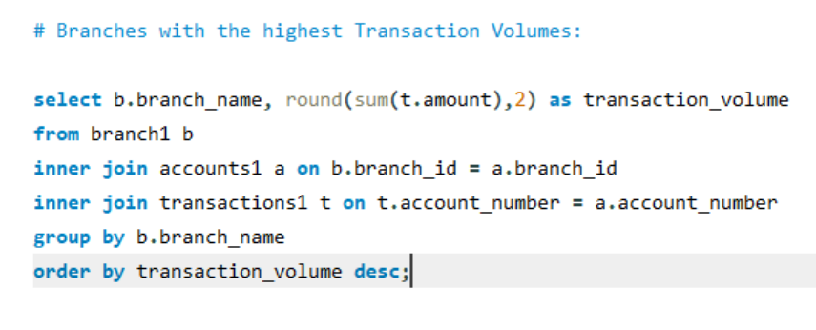
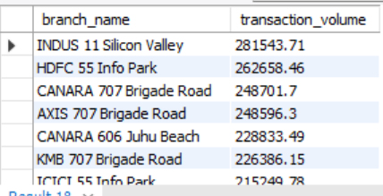
3.3 Branch Insight:
Insight:
Indus 11 Silicon Valley has the highest transaction volume and it is the most active branch.
1 High Transaction volume branches indicate strong customer activity, engagement and higher profitability
2.Low transaction volume branches may have few customers or limited business opportunities.
Recommendation :
1.Focusing on staff and technology on high volume branches to maintain service quality.
2.Investigating low volume branches to identify the cause like low customer base poor marketing or regional factors.
3.Opening new branches in high activity areas and strengthening digital channel where in Branch transactions are low.
Objective : To find most active branches

Slide 29
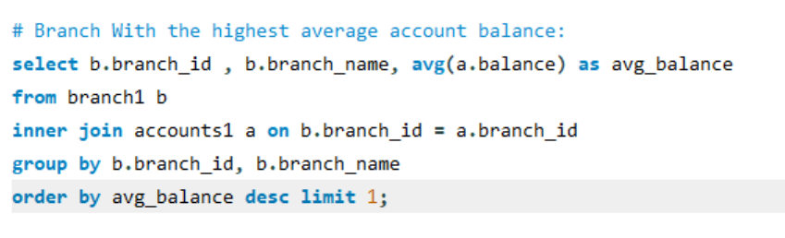
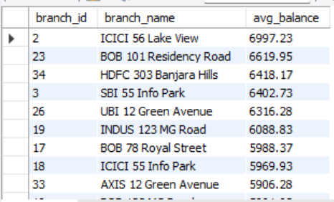
3.4 Branch Insight:
Insight : ICICI 56 LAKE VIEW has the highest average balance.
1.High average balance – indicates that the branch serves high-net-worth customers or large corporate accounts.
2.Low average balance – may reflect a customer base of smaller savers or more transactional users.
Conclusion:
1.Focus premium banking and investment services on branches with high average balances to deepen relationship with affluent clients.
2.Develop engagement strategies for low average balances to increase deposit through offers and cross selling.
Objective : To compare financial strength across all branches

Slide 30
👨‍💼 4. Employees Insights
Who is the most senior employee in each branch?
Who is the newest employee in each branch?
How many employees are there in each job position?
How long has each employee worked in the bank?

Slide 31
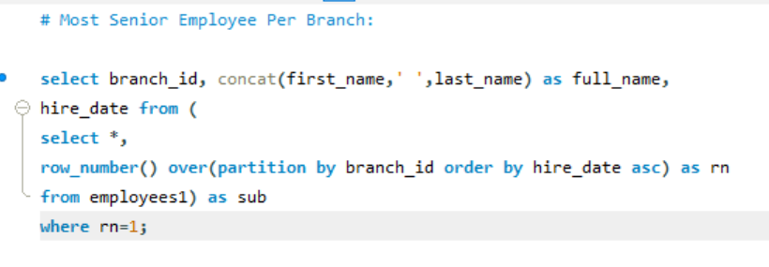
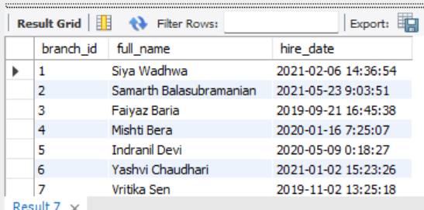
4.1 Employees Insight:
Insight: Branch with highly experienced may have stronger customer relationships, smoother operations and higher stability.
2.Branches with low seniority levels may indicate recent expansion high turnover or the need for more training and stability.
Recommendations:
1.Recognize and reward senior employees for their long - term contribution and experience.
2.Leverage senior staff for mentoring, leadership roles or training newer employees.
3.Address retention challenges in branches with fewer long tenured employees.
Objective : To determine the longest serving employees across all branches

Slide 32
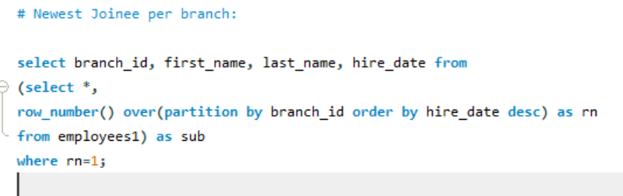
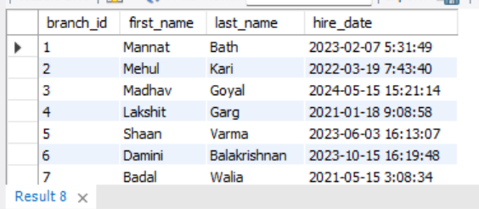
4.2 Employees Insight:
Insight:
1.Branches with recent joinee may indicate business growth, staff replacement, or expansion in those locations.
2.Branches with no recent hires could imply stable teams or potential stagnation in workforce development.
Recommendations:
1. Focus training and orientation programs in branches with multiple new joiners to improve productivity.
2.Recognize growing branches and ensure adequate managerial and resource support.
Objective : To evaluate branch-level hiring trends and plan workforce strategies effectively.

Slide 33
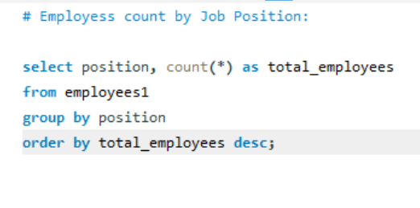
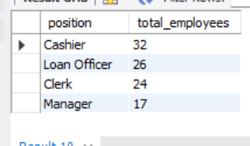
4.3 Employees Insight:
Insight:
1.Cashier form the largest workforces in the banks strong focusing on customer service and transaction handling.
2. Loan Officers and Clerks also make up a significant portion of staff, showing that lending and administrative operations are key functions
3. Managers have the smallest count, which is expected since management roles are supervisory and fewer in number.
Objective : To analyze the workforce distribution across different job roles

Slide 34
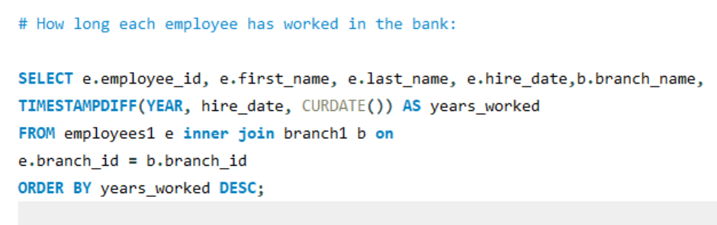
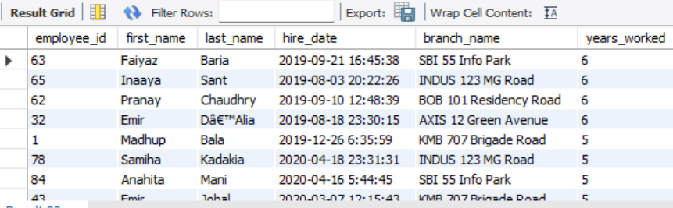
4.4 Employees Insight:
Insight:
Long-tenured employees → Indicate strong retention, loyalty, and organizational stability.
Short-tenured employees → Suggest recent recruitment, expansion, or potential turnover issues.
Branch-level comparison → Reveals which branches have experienced or new staff.
Experience distribution → Helps in succession planning and mentoring programs.
Objective : To determine the tenure of each employee in the bank

Slide 35
5.Advanced Cross Functional Insight:
What is the moving average of transactions over the last three months?
What is the customer lifetime proxy?
Which accounts have more than five transactions per day?
What is the average number of transactions per customer per month over the last year?
5. Find out the customers whose average transaction is higher than bank
Overall average transaction amt.
6. How are branches ranked based on total deposits in the last quarter?

Slide 36
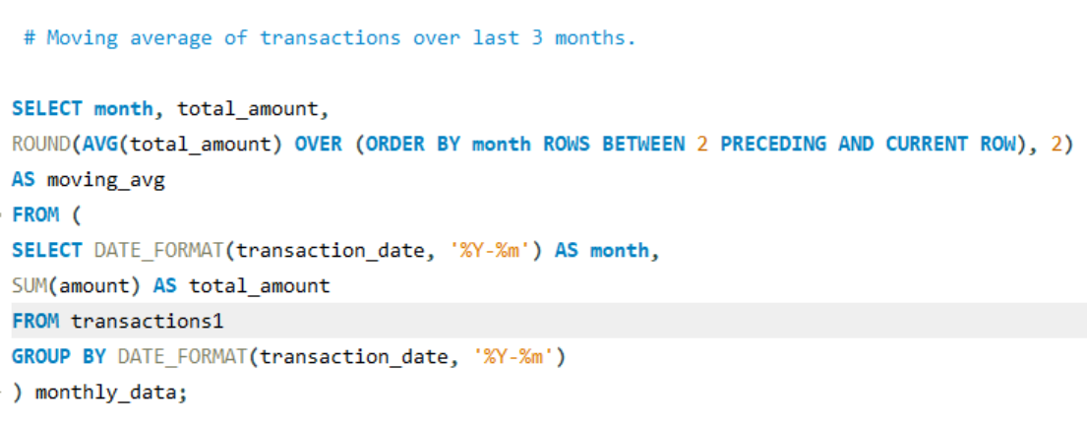
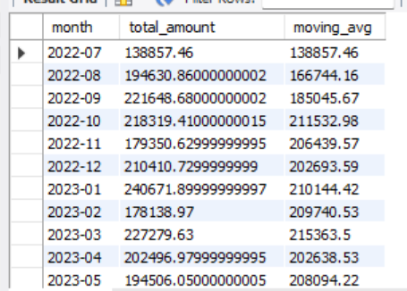
5. 1 Cross functional Insight:
Insights:
Rising moving average → Indicates growing customer engagement or increasing transaction activity.
Declining moving average → Suggests reduced activity — possibly due to seasonality, customer churn, or economic factors.
Stable moving average → Reflects consistent performance and steady customer behavior.
Pattern recognition → Helps identify seasonal trends, the impact of promotions, or market changes.
Objective : To analyze transaction trends and understand whether customer activity is increasing, stable, or declining over time.

Slide 37
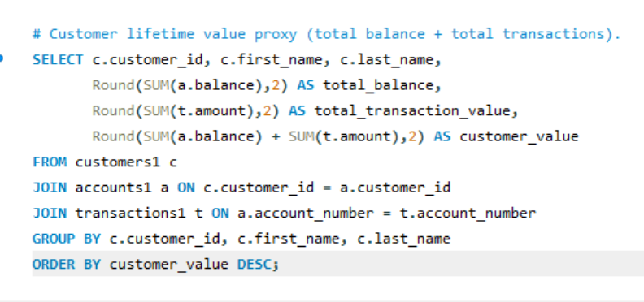

5.2 Cross Functional Insight:
Insights:
High balance + high transactions → Most valuable and engaged customers — likely loyal and profitable.
High balance + low transactions → Wealthy but less active customers — potential for cross-selling or investment products.
Low balance + high transactions → Active users with smaller balances — potential to promote savings or credit products.
Low balance + low transactions → Dormant or low-engagement customers — may need reactivation strategies.
Objective :
To identify high-value and loyal customers
who contribute most to the bank’s performance.

Slide 38

5.3 Cross Functional Insight
Objective : To find unusual transactions and fraudulent activity by customers
Insight:
Unusually high number of daily transactions may indicate potential fraud, duplicate orders, or bot activity.

Slide 39

5.4 Cross Functional Insight:
Objective : Track changes in engagement and usage behavior over the past year.
Insight:
1.Helps identify whether customers are actively using their accounts or remaining dormant.
2.Indicates how customers interact with their accounts e.g., frequent low-value transactions vs. occasional high-value ones.
3. Rising transactions averages improving customer engagement and retention while declining trends indicates reduced usage possibly due to dissatisfaction or competition.

Slide 40


5.5 Cross Functional Insight
Objective : To identify the high value customers.
Insight:
High-transaction customers can be targeted for premium offers, loyalty rewards, or relationship management programs.

Slide 41

5.6 Cross Functional Insight:
Objective : To identify the best-performing branches based on the total deposit amount in the most recent quarter.
Insight:
Branches with the highest deposits in the last quarter demonstrate strong customer engagement, effective deposit mobilization strategies, and higher regional financial activity.

Slide 42

Power BI Dashboard

Slide 43


Slide 44


Slide 45
Conclusion: The Banking Customer Analytics Project provides a comprehensive understanding of customer behavior, transaction trends, branch performance, and employee efficiency.
Customer Concentration: Mumbai has the largest customer base, while smaller cities like Mysuru offer growth potential.
Account Trends: Savings accounts hold the highest average balances, making them the key contributors to deposits.
High-Value Clients: A few customers contribute a large share of total deposits — these are critical for retention and relationship management.
Inactive but Wealthy Customers: Several customers maintain large balances but show low transaction activity — a missed engagement opportunity.

Slide 46
Conclusion:
5.Transaction Insights: Transfers dominate all transaction types, reflecting a shift toward digital banking and inter-account movement.
6.Seasonal Peaks: Transaction volume peaks around May, indicating spending surges linked to bonuses, holidays, or promotions.
7.Branch Insights: Indus Silicon Valley is the best-performing branch with the highest balance and transaction volume, while low-traffic branches may need strategic review.
8.Employee Insights: Branches with experienced employees show better performance and customer satisfaction.
9.Customer Segmentation: Older customers contribute higher transaction values, while younger customers show digital engagement potential.

Slide 47
💡 Recommendations
1. Strengthen Customer Retention and Engagement
Re-engage inactive high-balance customers with personalized offers, higher interest rates, or exclusive loyalty programs.
Offer cashback and rewards for increased transaction activity to boost engagement and reduce dormancy.
Use targeted marketing campaigns for customers with low balances but high activity to promote savings or investment accounts.
2. Leverage Data for Personalized Banking
Use customer segmentation analytics (age, balance, activity) to offer tailored financial products such as investment plans, premium savings, or retirement schemes.
Build customer lifetime value (CLV) models to prioritize service quality for high-value and high-transaction clients.
3. Boost Digital Banking Adoption
Expand and simplify digital transfer and payment channels, since transfers dominate transaction activity.
Promote mobile and online banking usage through tutorials, referral bonuses, or convenience-driven offers.
Use data to identify customers still relying on in-branch transactions and guide them toward digital alternatives.

Slide 48
Recommendations
4. Optimize Branch Performance
Reward and retain experienced staff in high-performing branches to maintain service quality.
For underperforming branches, analyze customer profiles, local competition, and marketing gaps to plan recovery strategies.
Reallocate employees to balance workloads — ensure busy branches have adequate staff and technology support.
🔹 5. Enhance Cross-Selling and Upselling
Target high-transaction customers for credit cards, loans, or investment products.
Use transaction frequency and balance data to identify cross-sell opportunities (e.g., insurance, fixed deposits).
Offer bundled financial services to loyal customers to increase wallet share.
🔹 6. Risk and Fraud Monitoring
Continuously monitor unusual transaction spikes or repetitive low-value activity for potential fraud or system misuse.
Implement real-time alerts for anomalies based on historical behavior and thresholds.
🔹 7. Strategic Growth and Market Expansion
Focus on cities with fewer customers (like Mysuru) by increasing marketing, partnerships, and financial literacy programs.
Open digital-only branches or kiosks in low-performing regions to reduce operational cost while improving accessibility.

